Slide 1
TIME SHARED COMPUTER MODEL
MODELING AND SIMULATION
SUMITTED TO: MA’M HUMERA AZAM

Slide 2
GROUP MEMBERS
ABDUL MUNIM IMRAN B15101004
ANAS AHMED B15101014
BILAL AHMED B15101025
BILAL ZAFAR B14101051
HAMZA SIDDIQUI B14101036
MUHAMMAD ANAS ZUBAIR B15101062
MUHAMMAD MUNEEB SHEIKH B15101085
MUHAMMAD SHARIQ NAEEM B14101064
SYED MUHAMMAD FAIZAN HAIDER SHAMS B15101135
TAIMOOR ABBASI B14101112

Slide 3
PROBLEM STATEMENT
A company has a computer system consisting of a single central processing unit and terminals. The operator of each terminal thinks for an amount of time that is an exponential random variable with mean 25 seconds and then to the CPU a job having service time distributed exponentially with mean 0.8 seconds. Arriving jobs join a single queue for the CPU but are served in a Round-Robin rather than FIFO manner. That is, the CPU allocate to each job a maximum service quantum of length q = 0.1 second. if the (remaining) service time of a job, s second, is no more than q , the CPU spends s second, plus a fixed swap time of r =0.015 second, processing the job, which then return to its terminal. However, if s > q, the CPU spends q + T seconds processing the job, which then joins the end of the queue, and its remaining service time is decremented by q seconds. This process is repeated until the job's service is eventually completed, at which point it returns to its terminal, whose operator begins another think time.
Let Ri be the response time of the ith job to finish service, which is defined as the time elapsing between the instant the job leaves its terminal and the instant it is finished being processed at the CPU. For each of the case n = 10, 20, 30, . . ., 80 we simlib to simulate the computer system for 1000 job completions (response times) and estimate the expected average response time of these jobs, the expected time-average number of jobs waiting in the queue, and the expected utilization of the CPU. Assume that all terminals are in the think state at time 0. The company would like to know how many terminals it can have on its system and still provide users with an average response time of no more than 30 seconds.

Slide 4
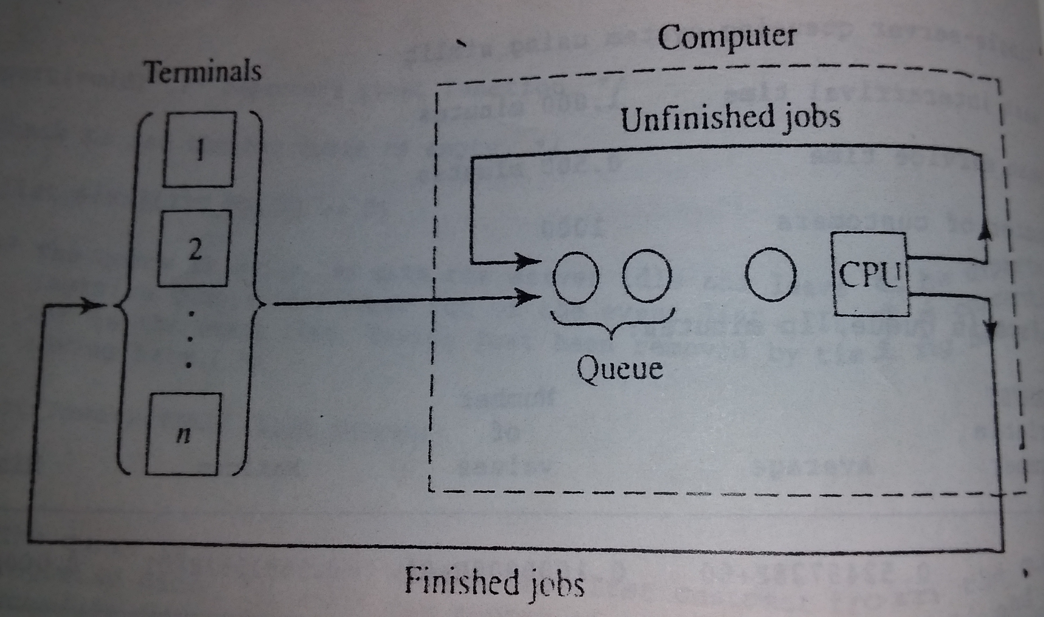
Block Diagram

Slide 5
Description Of Vocabulary Used In This Process
Mean Think Time The average time of terminal operator assigning a job to the CPU.
Mean Service Time The average time to complete a process.
Quantum Time to serve a process in a round.
Swap Time Switching time between the processes.

Slide 6
EVENT LIST
ARRIVAL: Arrival Of A Job To The CPU From A Terminal, At The End Of Think Time.
2. END CPU RUN: When A Job Either Completes It Service Requirement Or Has Received The Maximum Processing Quantum Queue.
3. TERMINATION: End Of The Simulation.

Slide 7
ROUND ROBIN SCHEDULING:
TECHNIQUE TO SOLVE THE PROBLEM
Round-robin is one of the algorithms employed by process and network schedulers in computing. As the term is generally used, time slices (also known as time quanta) are assigned to each process in equal portions and in circular order, handling all processes without priority (also known as cyclic executive). Round-robin scheduling is simple, easy to implement, and starvation-free. Round-robin scheduling can also be applied to other scheduling problems, such as data packet scheduling in computer networks. It is an operating system concept.
The name of the algorithm comes from the round-robin principle known from other fields, where each person takes an equal share of something in turn.

Slide 8
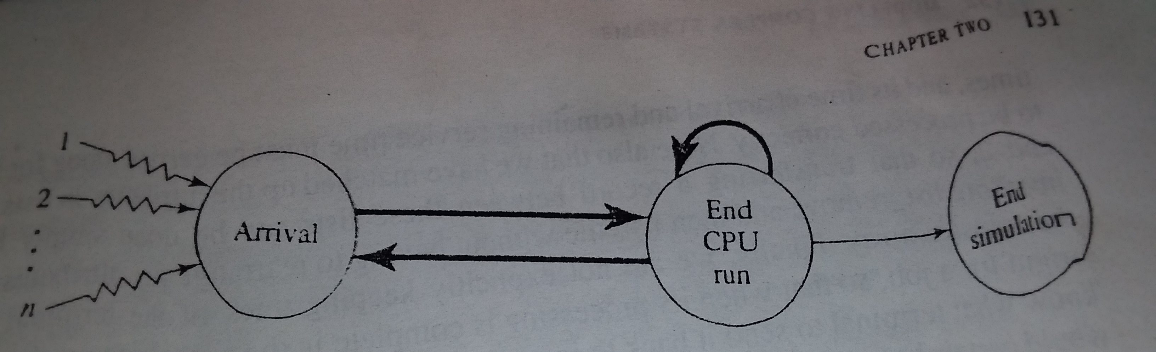
Event Diagram

Slide 9
INPUT
PROCESS
OUTPUT
NUMBER OF TERMINALS
MEAN THINK TIME
MEAN SERVICE TIME
QUANTUM
SWAP TIME
NUMBER OF JOBS PROCEED
ARRIVE AT CPU
START CPU PROCESSING
END CPU PROCESSING
GENERATION OF REPORT
AVERAGE RESPONSE TIME
AVERAGE WAIT IN QUEUE
UTILIZATION OF CPU

Slide 10
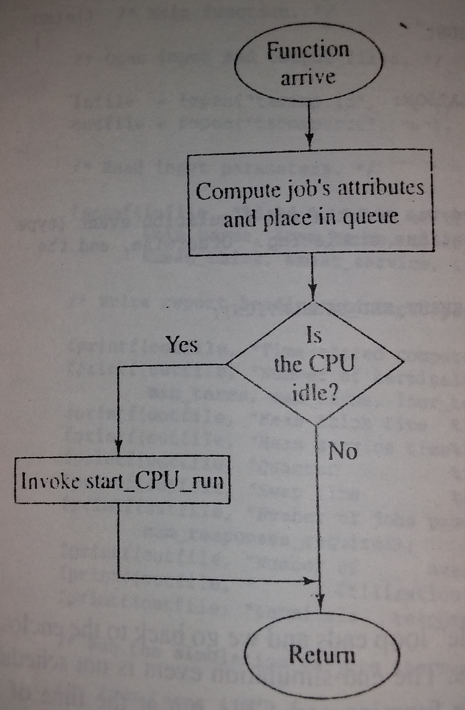
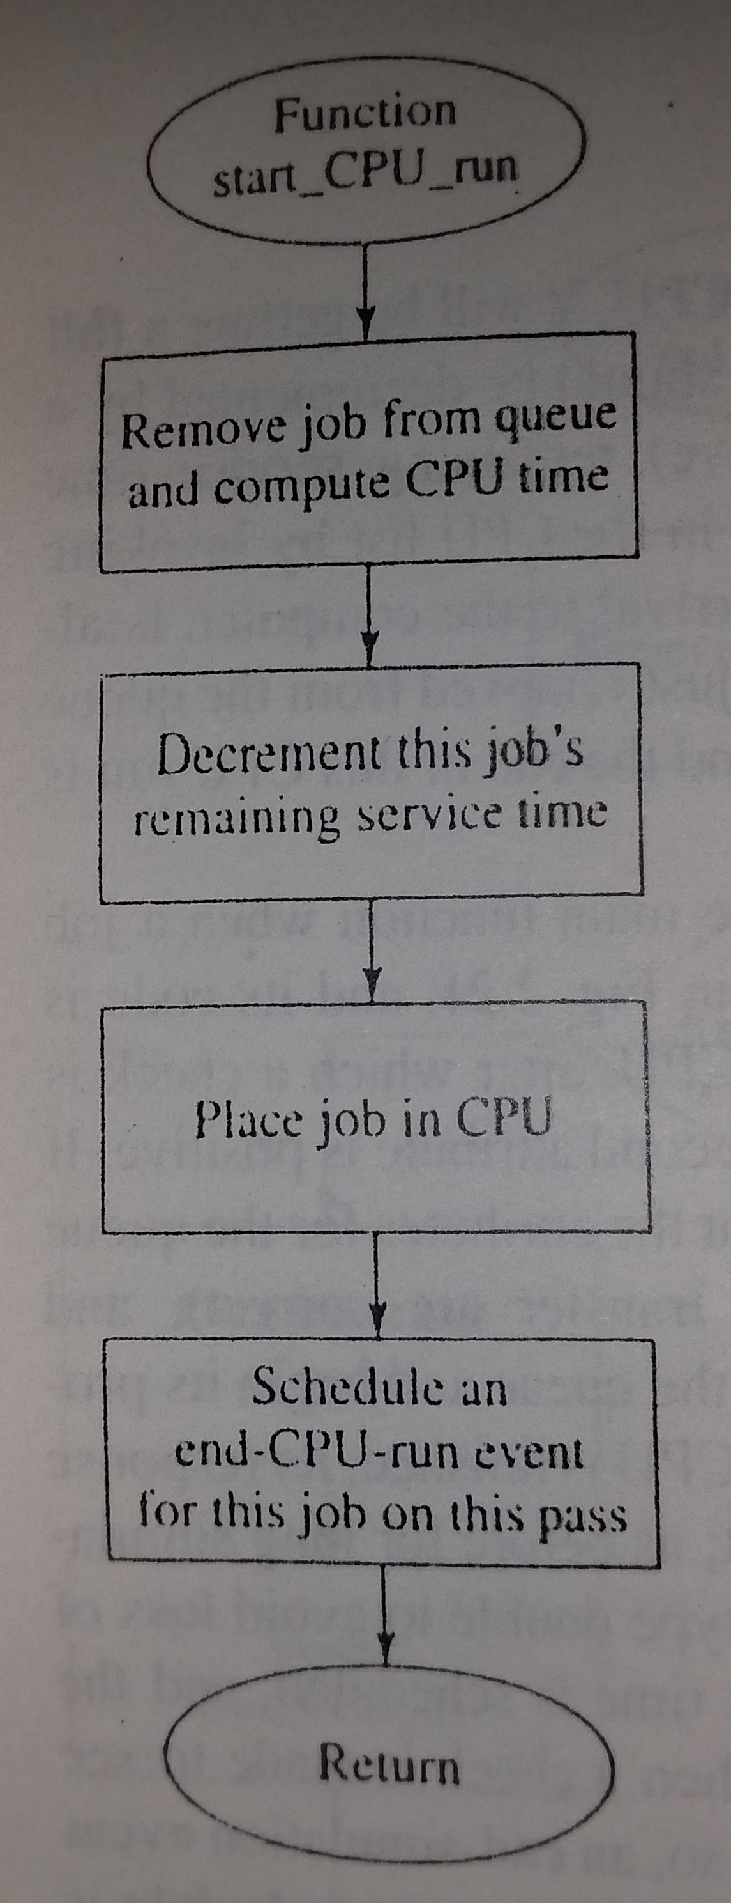
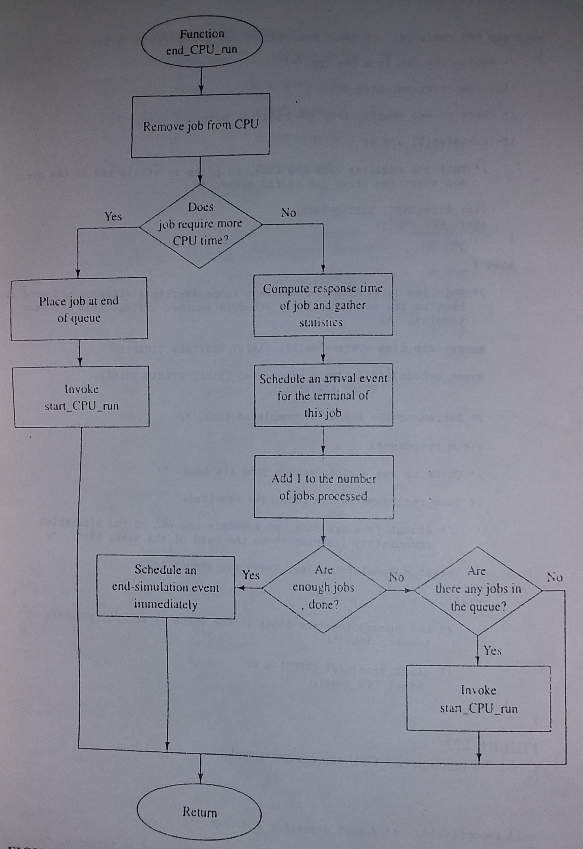
FLOW CHART OF PROCESSES
Arrival Function
Start CPU Run
End CPU Run

Slide 11
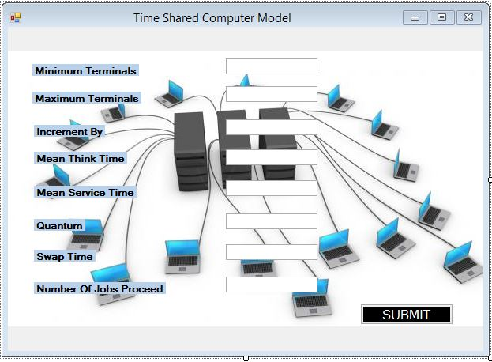
INPUT VIEW OF SIMULATION:

Slide 12
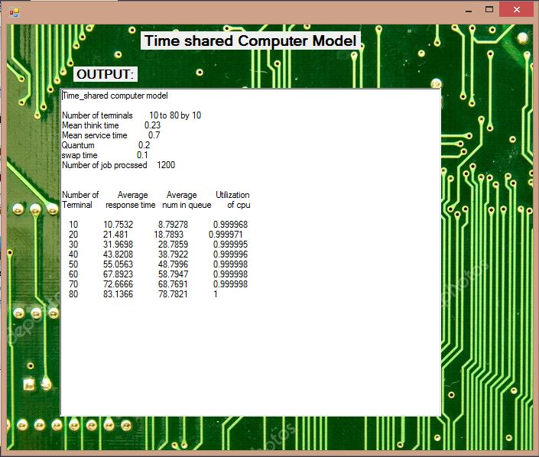
OUTPUT VIEW OF SIMULATION:

